Slide 1
Impact of industrial action on elective waiting list
Harrow Health and Wellbeing Board
13 September 2023

Slide 2
Industrial action so far in 2023, past and planned
To date there has been 5 sets of junior doctor strikes and 2 consultant strikes completed.
Currently there is a further 2 consultant strikes planned across September and October.
During each strike the Trust implemented a Gold Command approach similar to what was set up during the Covid pandemic.
Leading up to each strike, staffing rotas were planned to schedule as much activity as possible, whilst maintaining clinical safety.
Additional daily checkpoint huddles and staffing safety checks were implemented during the days of the strikes.

Slide 3
Prioritising of capacity
Throughout the various instances of industrial actions, there has been a necessity to decrease overall activity.
The determination of which activities should proceed was guided by the following factors:
Clinical urgency
Patients on a cancer treatment pathway
Patients who had surpassed a 52-week waiting period on a referral-to-treatment (RTT) pathway
Activities that could be sustained without adversely affecting the workforce required to provide secure care within hospital wards.

Slide 4
Impact of industrial action on planned activity
To date across the strikes, the following activity has been impacted
6,607 outpatient cancellations
968 elective ordinary operations (cases requiring an overnight admission post operation)
993 elective day case procedures (cases where the patient is discharged on the day of the procedure)
Percentage of elective activity (operations) impacted
During the initial strike, day case activity was reduced by 28% and elective ordinary cases by 43%
The second strike had the largest impact as this was scheduled during the Easter Bank Holiday week, which doubled the cancellations
The next set of junior doctor strikes had a lower impact as more doctors remained on the rota
Percentage of outpatient activity impacted
During the initial strike in June, outpatient appointments were impacted by 25%
The second strike had the largest impact as this was scheduled during the Easter Bank Holiday week, increased the impact to 43%
The next set of junior doctor strikes had a much lower impact as more doctors remained on the rota, where only 11% of appointments were impacted

Slide 5
Impact of industrial action on planned waiting lists
The impact on the post-covid elective waiting list recovery
77.4% of the cancellations been waiting for less than 52 weeks
5.3% of the cancellations been waiting for more than 52ww
1.5% of the cancellations been waiting for more than 65ww
0.2% of the cancellations been waiting for more than78ww
The impact on the elective waiting list was as follows:
15.6% of the cancellations were on an urgent two week wait pathway

Slide 6
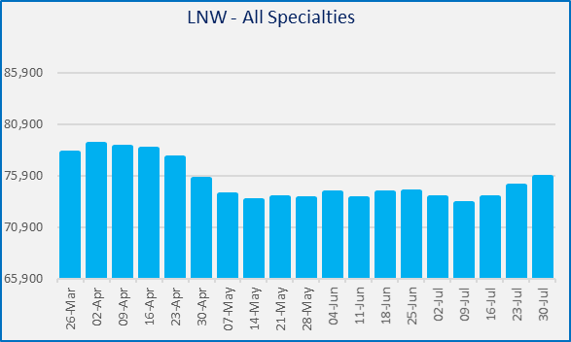
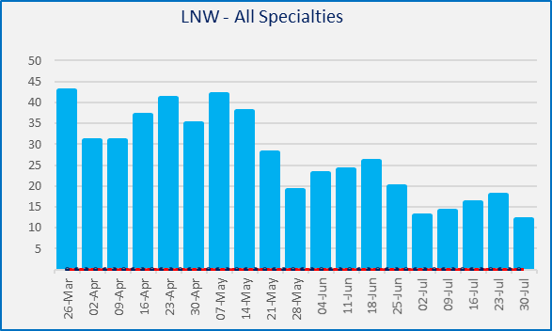
Impact on waiting list size
The strikes have had an impact on wait times for our patients however the Trust has ensured it prioritises patients based on clinical urgency, cancer and those patients who have waited a long time, had cancellations previously and managed to keep the PTL stable and continue to reduce the longest waiting patients over 78 weeks.
Total PTL
Over 78 weeks PTL

